Slide 1






Microsoft Power Platform
Community call
Welcome to the May 2022
Power Platform Community Call!
May 18th, 2022
Notes:
Hello and thank you for joining us today. Welcome to the April 2022 Power Apps Community Call! I’m Todd Baginski and I'm really excited to bring you another fun month of Power Apps goodness.
Monthly cadence
Every month on the ‘third’ Wednesday
Next call: May 18th, 2022 - 08:00am PST
Latest news and community contributions
Meet the product teams behind Power Apps
Technical deep dives
The Power Apps Community Call chat channel includes Microsoft Power Apps team members, Fast Track Recognized Solution Architects, Power Apps MVPs, Power Apps Champions, and #PowerAddicts!
Q&A
This month is a little bit different as we welcome the new Power Apps Community Program Manager, David Warner. David and I have been working together for the last few weeks and are excited to bring some new, fun features to the call. David, welcome!!!!
David: Thanks Todd. I'm super excited to be part of this community, but ya know, I was thinking, even though I'm the Power Apps CPM, isn't community all about being inclusive and collaborative?
Todd: ABSOLUTELY, you know it!
David: Then lets make some changes immediately. I'm happy to announce this community call will include coverage of the entire Power Platform and will become the Power Platform Community Call!

Slide 2





Agenda
Latest updates and news on Power Platform
Group picture time with Together Mode!
Demos
Rene Modery - Automatically generate technical documentation of your Power Apps and Power Automate Flows
Heidi Jordan - Streamline Annual Document Reviews with Power Apps
Amber Weise - Power Platform + Microsoft Teams: Create a "back-channel"​ internal chat for any meeting

Slide 3

Community Call Format
Community Updates (15 Minutes)
Demo #1 (15 Minutes)
Demo #2 (15 Minutes)
Demo #3 (15 Minutes)

Slide 4

Request to Present We welcome everyone to present a demo on the Power Platform Community Call. Everyone is welcome!!!
https://aka.ms/PPCCDemoRequest

Slide 5
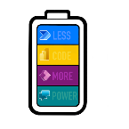
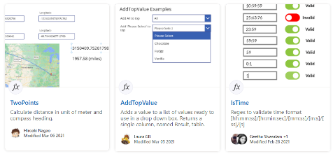
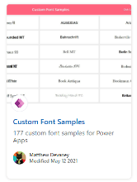
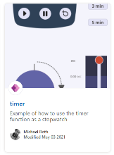
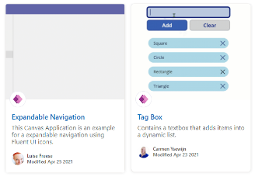
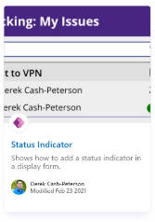
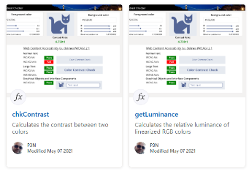
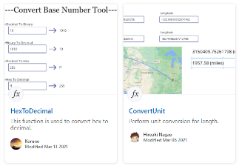
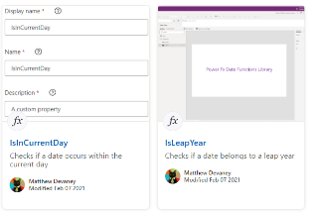
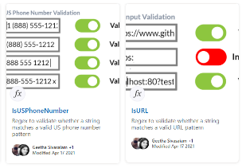
Power Platform Samples
https://aka.ms/powerplatform-samples ​
https://adoption.microsoft.com
Power Apps templates​
Power Apps components​
Power Apps connectors​
Power Fx Custom Functions
Power Automate flow templates​​
PowerBI​​
Power Virtual Agents​​

Slide 6
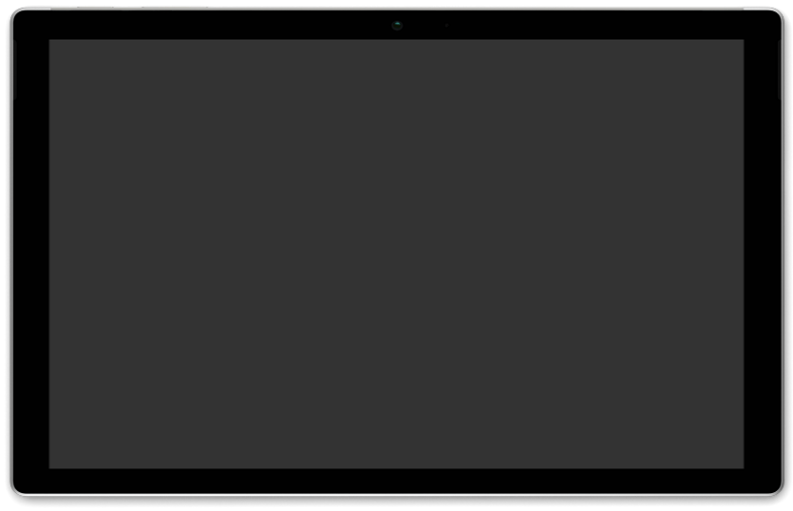
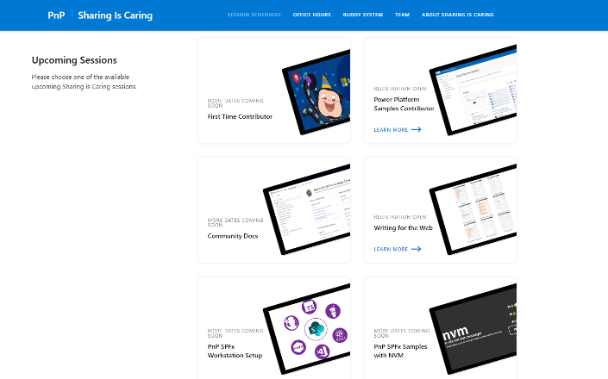
GUIDANCE
Learn how to get started in the open-source community!
Upcoming Sessions:
First-time contributor
Power Platform Samples Contributor
Writing for the Web
Community Content Docs
SPFx Developer Workstation Setup
Using PnP SPFx samples w/ NVM
More than code with VS Code
First-time presenter
M365 Maturity Model Practitioners
Join the Power Platform Contributors
Sharing is Caring Session – May 31st
https://aka.ms/sharing-is-caring
Notes:
25 Total attendees, 16 attendees who attended both First-Time Contributors and Community Docs sessions.

Slide 7








COMMUNITY
Community Recognition Program
Showcasing your contributions
Powered by Credly
More achievement levels coming soon
https://aka.ms/m365pnp-recognition
Notes:
25 Total attendees, 16 attendees who attended both First-Time Contributors and Community Docs sessions.

Slide 8

Power Platform Community Events

Slide 9
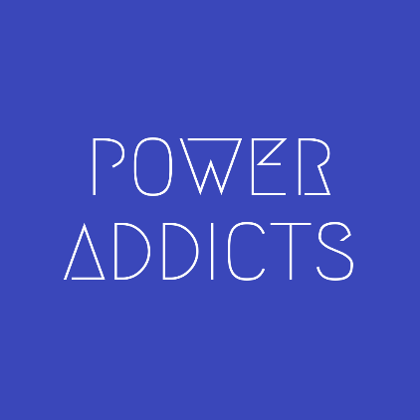
Power Addicts Hangout
#PowerAddict : An individual with an almost obsessive need and desire to bring positive change, solve problems and automate processes with the Microsoft Power Platform.
https://WeArePowerAddicts.com

Slide 10
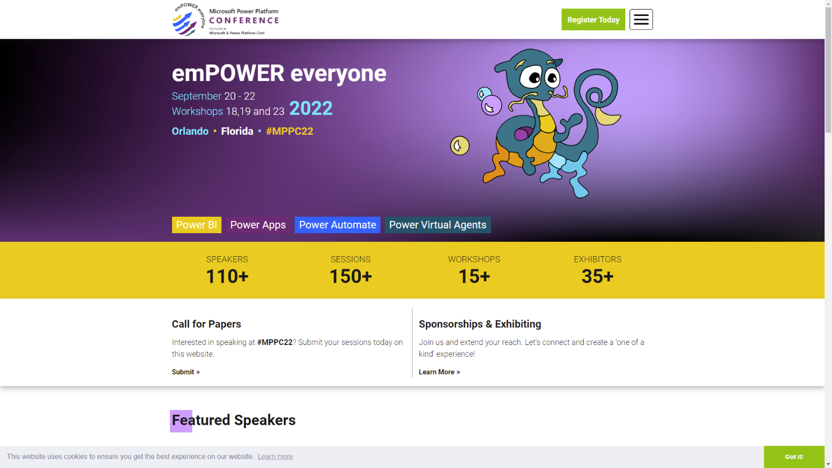
https://powerplatformconf.com/

Slide 11




Slide 12


Slide 13
Recent News

Slide 14
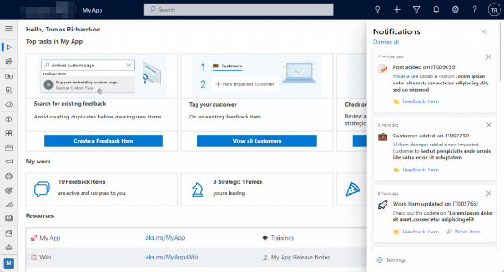
Model-driven In-App Notifications
General Availability
https://aka.ms/PAModelNotifications

Slide 15
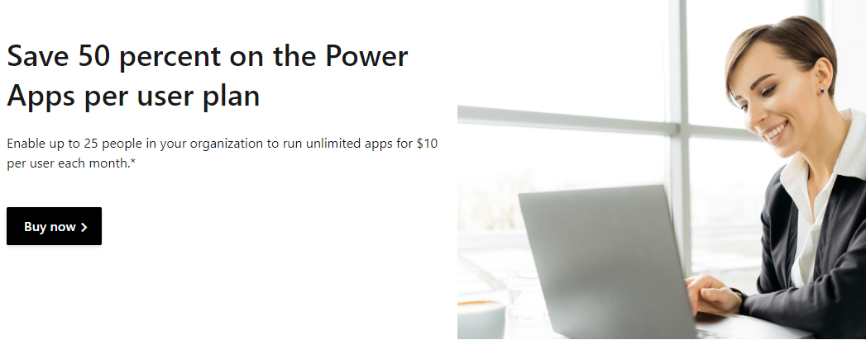
Half Off Power Apps
Save 50 percent on the
Power Apps per user plan
https://aka.ms/PowerPerUserPromo

Slide 16
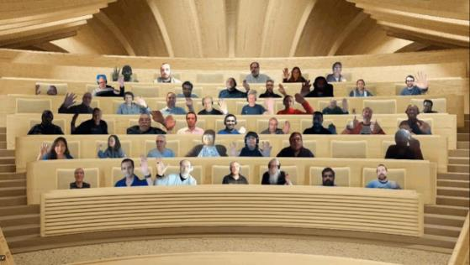

Optional picture time!
Turn your video on and we’ll grab a Together Mode picture with everyone willing to participate.
We are together in this as a community!
By enabling your camera for the picture, you’ll give us the permission to share your picture in social media.

Slide 17




DEMO
Automatically generate technical documentation of your Power Apps and Power Automate Flows
- Rene Modery
Streamline Annual Document Reviews with Power Apps
- Heidi Jordan
Power Platform + Microsoft Teams: Create a "back-channel"​ internal chat for any meeting
- Amber Weise
Notes:
Rene: PowerDocu is a free open-source tool that allows anyone to generate technical documentation of canvas apps and Flows. This demo will explain how PowerDocu can help with generating documentation, and shown in detail how it can be used with apps, Flows, and solutions.
Heidi:
This was my very first Power App that I put into production. It took me months to design, all fueled by twitter/videos/blog posts from the community experts. THANK YOU! That being said, I would like to show the components of my Policy Revision Request form. Big picture - companies have documents that need to be accessible to all employees and reviewed annually (policies, procedures, etc.) Edits must be tracked/approved and new documents must flow through the same approval process as the annual reviews.
Putting this all together - I built a SharePoint library to house these documents, a customized list form in Power Apps to handle the review request, and a flow to handle the actual approval/sign off piece. This is a rather large solution but I was hoping to highlight the Power Apps piece of it which includes:
1. A request form where users can choose to add a new document to the policy library or request to revise the current version in the policy library.
2. Form filtering - documents are categorized by Department and Document Category. I am pulling these values from the Policy library so no one has to manually maintain a choice field. Also, when a Department and Category are selected, the user is presented with a filtered dropdown of the documents from the selected combination. They can then choose which document they'd like to request a revision for.
3. Attachments - users can add attachments to the form and I am then pushing these to an In Progress SharePoint document library where they can be reviewed.
4. Form design - I'd like to highlight a few things here: using buttons with images to set choice values, bring in user photo/name and change the color of the submit button when all required fields are filled in.
If time allows, I can also showcase some of the SharePoint and Power Automate pieces. i.e. Adaptive cards in Teams for the Approval process, SharePoint list formatting on the In Review request list, etc.
Amber:
QuickChat is a Power Apps application designed for you to quickly create internal Microsoft Teams group chats for any meeting on your calendar. If you’ve ever created an internal chat – often called a back-channel/backstage chat – for a meeting, you know that it’s a manual process that is time-consuming and error prone. QuickChat allows you to quickly create these internal group chats. Simply click on the associated meeting in the Power App and a Power Automate workflow will grab all required attendees, filter out external attendees, and create a Teams group chat.

Slide 18
Resources

Slide 19
Learn more with these helpful resources!
Power Apps Training Resources
https://aka.ms/PowerAppsTraining
Power Apps Community
https://Community.PowerApps.com
Power Apps Community Samples
https://aka.ms/PowerAppsCommunitySamples
Power Apps Community Videos
https://aka.ms/PowerAppsCommunityVideos
PowerPlatformLearn Resources
https://www.powerplatformlearn.academy
PnP Power Platform Samples
https://www.aka.ms/powerplatform-samples
Create SharePoint List
https://bit.ly/CreateSharePointList

Slide 20
Microsoft 365 developer community calls
Microsoft 365 platform (weekly) https://aka.ms/m365-dev-call
(Notice. This call is on a summer break between July 1st and 31st of August 2022)
Adaptive Cards https://aka.ms/adaptivecardscommunitycall
Microsoft identity platform https://aka.ms/IDDevCommunityCalendar
Office Add-ins https://aka.ms/officeaddinscommunitycall
Power Platform https://aka.ms/PowerPlatformCommunityCall
Microsoft 365 & Power Platform Development (bi-weekly) https://aka.ms/m365-dev-sig
Viva Connections & SharePoint Framework (bi-weekly) https://aka.ms/spdev-spfx-call
Download recurrent invites from
https://aka.ms/m365/calls
Notes:
m365-dev-sig

Slide 21
Thank you
Recording will be available soon on the
Microsoft 365 Community (PnP) YouTube channel
https://aka.ms/M365PnP/videos
(subscribe today)
Follow us on Twitter
@Microsoft365Dev | @M365PnP
Next call: June 15, 2022 at 08:00am PST
https://aka.ms/powerplatformcommunitycall
See all other community calls at http://aka.ms/m365pnp
Notes:
Mention that we will be updating the aka to the powerplatformcommunitycall, BUT the powerappscommunitycall will be updated to point to the new invite.

